Slide 1
Motion Sensor Cat Gate
An IST360 IOT Project
Chaoyi Wang

Slide 2
Problem Discripton

Slide 3
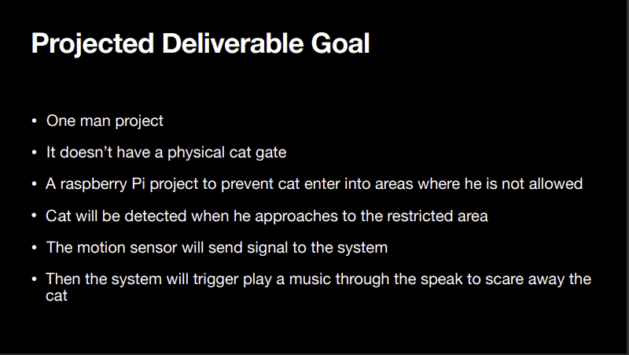

Slide 4
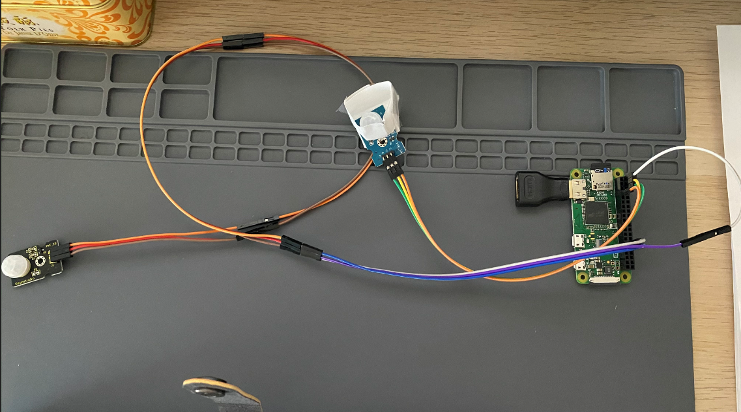
Current Setup
1 Rpi Zero
Soldered female header
Jump wires
Two PIR sensors
Sensor A use pin 12 and sensor B use pin4
Sensor A will be placed about 1/2’ above the floor
Sensor B will be placed about 4‘ above the floor
B
A

Slide 5
Changes & Challenges
Use 2 PIR sensors instead of 1
Advantage: 1 PIR cannot differentiate cat from human passing through
Cat can only trigger the sensor placed near ground
Human will trigger both sensors
Challenge:
2 PIR sensor do not necessarily being triggered simultaneously.
Proposed Solution:
Async functions / Callback functions
Milestones:
Tested GPIO.add_event_detect, timeouts, etc..
Python wait/async functons
Continue testing

Slide 6
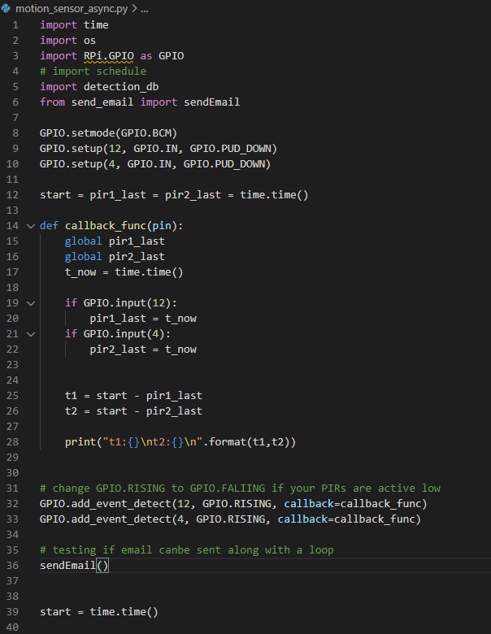
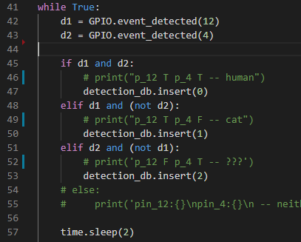
PIR Motion Detection
Two PIR sensors
Sensor A use pin 12 and sensor B use pin4
Sensor A will be placed about 1/2’ above the floor
Sensor B will be placed about 4 feet above the floor

Slide 7
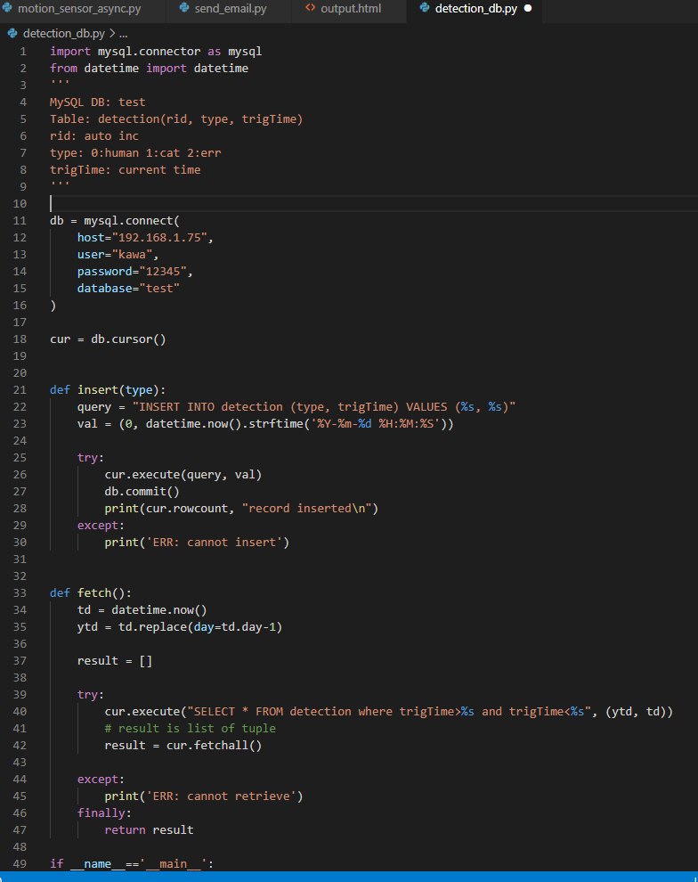
Connect to Database
Setup MySQL database on local NAS
DB’s remote access only available within the local network
Python script remotely connect to the database through mysql connector
Functions to insert and fetch records

Slide 8
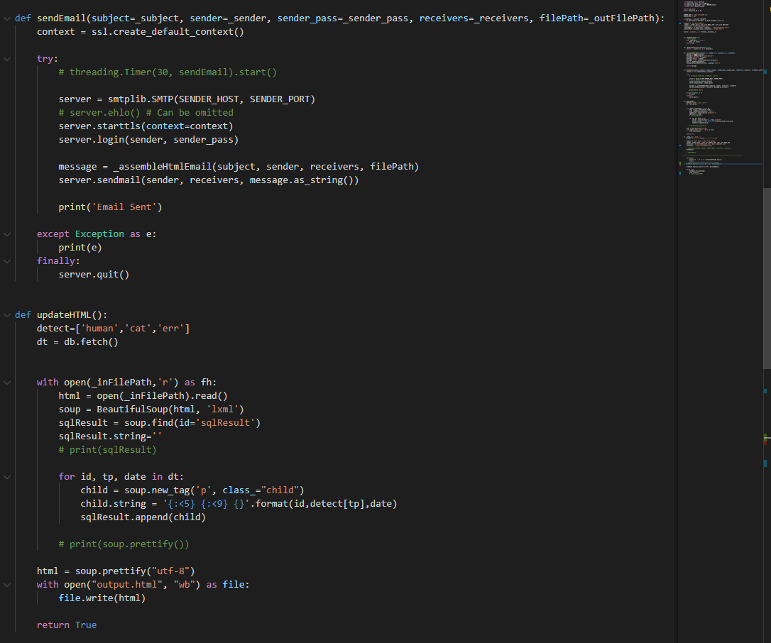
Email Daily Report
A scheduled task to send daily email contains the past 24hrs passing through records
Fetch records from database
Insert the records into an HTML file
Email the HTML file
Scheduling: 2 solution: threading.Timer() vs. schedule (python module)

Slide 9
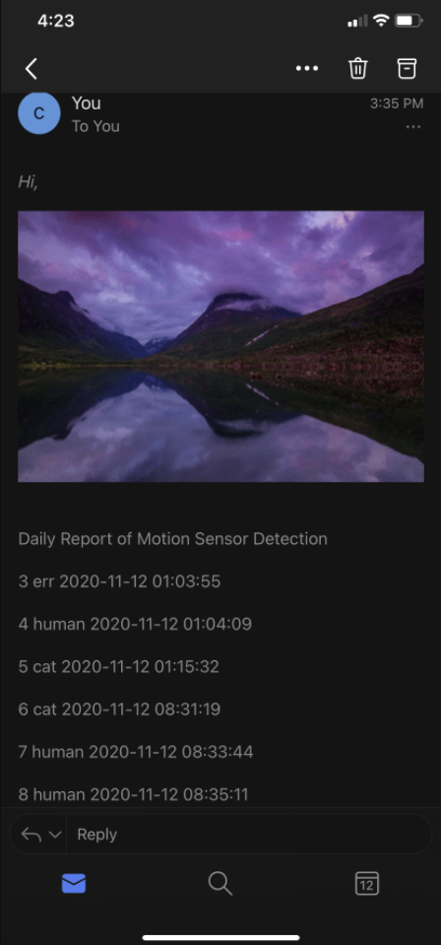
A Sample Email

Slide 10
What’s Next
Limitation:
Accuracy on motion detection, hard to decide a proper trigger time
Audio Connection – No headphone jack on RPi Zero, need to seek a budget friendly way to play sound.
Future Work:
Automatically start & run on each re/boot
A front-end website for checking status

Slide 11
The Problem
Proposed Solution(s)
Platform of choice and equipment for creating the solution
Milestones
Timeline

